Slide 1

SpaceX Falcon 9 First Stage
Landing Prediction
Gan Yu Yang
Created on: 17-May-2023

Slide 2

Executive Summary
Introduction
Methodology
Results
Discussion
Conclusion
Appendix
Table of Content

Slide 3

Executive Summary
This project involves training a machine learning model to predict and analyze the Space X Falcon 9 first stage landing. The goal is to determine the cost of each rocket launch and if the first stage will be landed. The methodology will included with Data Collection, Wrangling, Pre-processing, EDA, Visualization, as well as Machine Learning Prediction.

Slide 4
INTRODUCTION
The commercial space industry is growing rapidly.
SpaceX has achieved significant success due to their ability to reuse the first stage of their Falcon 9 rockets, significantly reducing the cost of rocket launches.
In this capstone project, we aim to analyze SpaceX's success in first-stage reuse and use machine learning techniques to predict the likelihood of first-stage landing success in future launches.

Slide 5

OBJECTIVE
Our primary objective is to determine the cost of a rocket launch by analyzing SpaceX's first-stage reuse success and creating dashboards for our team.
We will use publicly available information and train a machine learning model to predict if SpaceX will reuse the first stage.

Slide 6
IMPLICATIONS
This could pave the way for new companies to compete effectively with SpaceX and other established players.
Findings of this project have significant implications for the commercial space industry.

Slide 7

METHODOLOGY
Data Wrangling
EDA with Visualization
Create Dashboard
Data Collection
EDA with
SQL
Interactive Visual Analytics
Machine Learning

Slide 8

DATA COLLECTION
SpaceX API
Web Scraping
Request and Parse SpaceX data with GET request
Normalize JSON Response
Extract columns to be use
Create and filter new dataframe
Pre-processing data
Request rocket launch data from Wikipedia
Extract columns from HTML table
Parsing HTML table and create new dataframe
Pre-processing data

Slide 9
DATA WRANGLING
Calculate the number of launches for each launching sites
Calculate the number of occurrences for each orbit
Calculate the number of mission outcome occurrences
per orbit type
4. Create new lable for landing outcome

Slide 10
EDA WITH SQL
Unique Launch Sites
'CCA' Launch Sites
Successful and Failure Mission
Failed Drone Ship Landing in 2015
Boosters Success in Drone Ship Landing
Site names of unique launch sites in the space mission will be displayed.
Displaying 5 records where launch sites begin with the string 'CCA'.
Total number of successful and failure mission outcomes will be listed.
List failed landing in drone ship, booster versions, and launch site names in 2015.
List Boosters which have success in drone ship with payload mass >4000 & <6000.
NASA Boosters Payload Mass Carried
Average Payload Mass Carried
Date of First Successful Landing
Ranking Landing Outcomes
Booster Versions with Max Payload Mass
Total payload mass carried by boosters launched by NASA (CRS) will be displayed.
Average payload mass carried by booster version F9 v1.1 will be displayed.
Date when the first successful landing outcome in ground pad was achieved will be listed.
Count of landing outcomes between 2010-06-04 to 2017-03-20 will be ranked.
List booster versions which carried maximum payload mass.

Slide 11
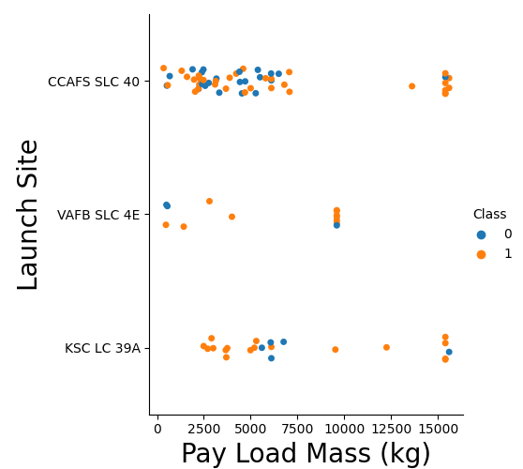
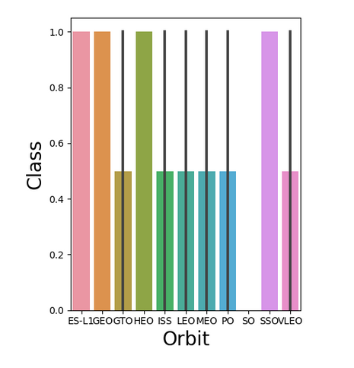
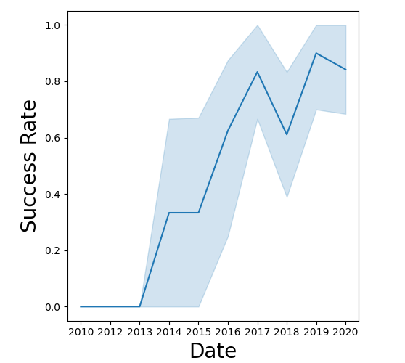
EDA WITH
VISUALIZATION
Scatter Plot
Bar Chart
Line Chart
The scatter plot is used to observe if there is any relationship between launch sites and their payload mass. We find that the VAFB-SLC launch site has no heavypayload mass (>10000kg).
The bar charts used for observe and analyze to find which orbits types have high success rate.
The line chart is used to visualize the average launch success trend by Year. We observe that the sucess rate since 2013 kept increasing till 2020

Slide 12

INTERACTIVE VISUAL ANALYTICS
We used Folium to perform interactive visual analytics to find an optimal location for building a launch site.
It is divided into three tasks:
Marking all launch sites on a map,
Marking the success/failed launches for each site on the map, and
Calculating the distances between a launch site to its proximities.
Hence, we were able to identify geographical patterns about launch sites.
Are launch sites in close proximity to railways?
Are launch sites in close proximity to highways?
Are launch sites in close proximity to coastline?
Do launch sites keep certain distance away from
cities?

Slide 13
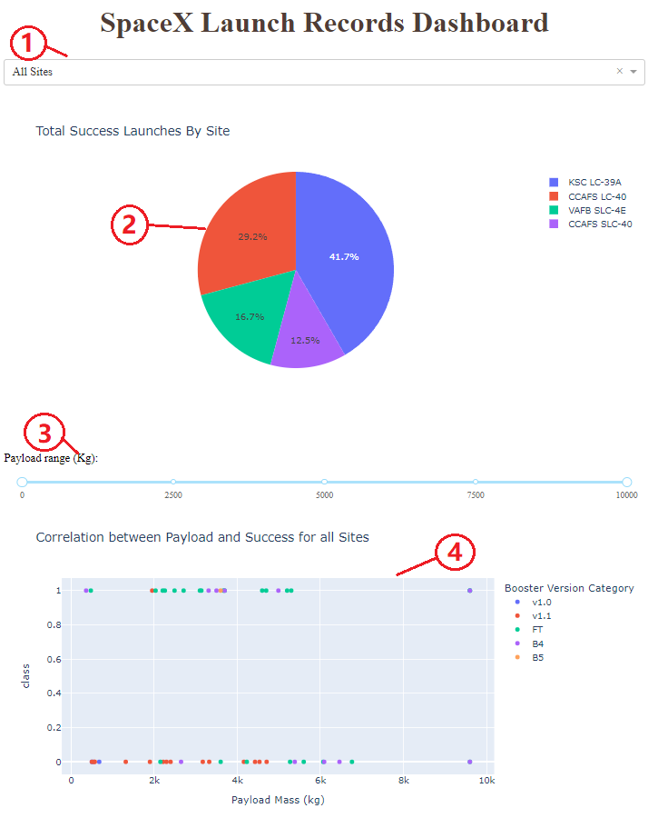
DASHBOARD USING
PLOTY DASH
Drop-down Input Component
choose between different launch Sites
Pie Chart:
render and return a pie chart graph to show the total success launches
Range Slider:
choose between different payload range
Scatter Plot:
visually observe how payload may be correlated with mission outcomes for selected site(s)

Slide 14
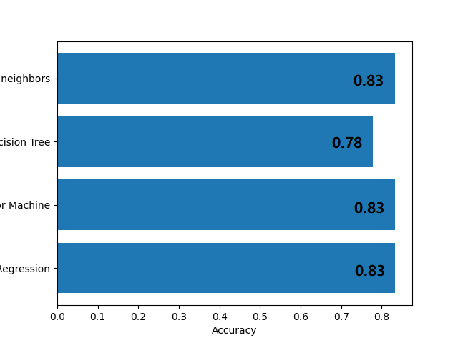
MACHINE LEARNING
This steps involving in performing Exploratory Data Analysis (EDA) and determine training labels as well as:
Create a column for the class
Standardize the data
Split into training data and test data
Then by comparing the machine learning method from SVM, Classification Trees and Logistic Regression to find the best hypermeter/performance using test data.

Slide 15
RESULTS
Falcon 9 Landing
Machine Learning
The results of the exploratory data analysis revealed that the average success rate of the Falcon 9 landings was ~67%.
From the predictive analysis, the K-Nearest Neighbors, Support Vector Machine, and Logistic Regression machine learning algorithms were found to has highest accuracy of 83.33%.

Slide 16
Conclusion
Number of flights and success rate are positively correlated.
Success rate improved over the years.
SSO, HEO, GEO, and ES-L1 are the most successful orbits.
Lighter payloads tend to have a higher success rate than heavier payloads.
Launch sites are located near highways and railways for transportation and far from cities for safety.
Decision Tree Classifier is the best predictive model for the dataset with 94% accuracy.

Slide 17
APPENDIX
Coursera Project Link: https://www.coursera.org/learn/applied-data-science-capstone/home/welcome
GitHub Repository: https://github.com/withouttheh/IBM-Data-Science-Capstone-Project

